Slide 1
Affinity Propagation
Affinity Propagation is a clustering algorithm that identifies exemplars among data points.
Unlike k-means, it does not require specifying the number of clusters beforehand.
It is based on message passing between data points.

Slide 2
Each data point is considered as a potential exemplar.
Responsibility and availability messages are exchanged iteratively.
Converges to find exemplars and form clusters.
It does not require predefined clusters.
It will find representative exemplars automatically.

Slide 3
Mean shift
Mean shift is a non-parametric clustering algorithm that finds dense regions in data.
It does not requires specifying the number of clusters.
It moves the data points iteratively towards the highest density area.

Slide 4
It selects the random points and calculates the density using a kernel.
It moves points towards the highest density region iteratively.
It stops when convergence is reached.
We need to predefine clusters and works with complex cluster shapes.
It is effective in density based clustering.

Slide 5
Spectral Clustering
A clustering algorithm that uses graph theory to partition data.
Converts data into a similarity graph and applies eigenvector decomposition.
Useful for non-linearly separable data.

Slide 6
Step 1: Construct a similarity graph.
Step 2: Compute the Laplacian matrix.
Step 3: Perform eigenvalue decomposition.
Step 4: Apply k-means clustering on eigenvectors.
Works well for complex and non-linearly separable data.
Handles arbitrary cluster shapes.
Uses global structure for clustering.

Slide 7
DBSCAN
Density-Based Spatial Clustering of Applications with Noise (DBSCAN).
The DBSCAN algorithm views clusters as areas of high density separated by areas of low density
Groups data based on density, identifying core, border, and noise points.
Useful for discovering clusters of arbitrary shapes.

Slide 8
Step 1: Select a random point and check its neighbors.
Step 2: Expand the cluster if density criteria are met.
Step 3: Mark noise points that don’t belong to any cluster.
Step 4: Repeat until all points are classified.
No need to specify the number of clusters.
It will Handles noise and outliers well.
It detects clusters of arbitrary shape.

Slide 9
.
HDBSCAN
Hierarchical Density-Based Spatial Clustering of Applications with Noise (HDBSCAN).
The HDBSCAN algorithm can be seen as an extension of DBSCAN and OPTICS
Specifically, DBSCAN assumes that the clustering criterion (i.e. density requirement) is globally homogeneous.
DBSCAN may struggle to successfully capture clusters with different densities
HDBSCAN alleviates this assumption and explores all possible density scales by building an alternative representation of the clustering problem.
Extends DBSCAN by analyzing cluster stability and hierarchy.
Automatically determines the number of clusters.

Slide 10
Step 1: Construct a mutual reachability graph.
Step 2: Apply single-linkage clustering.
Step 3: Condense the hierarchy to extract stable clusters.
Step 4: Assign soft clustering probabilities.
No need to specify the number of clusters.
Handles varying densities of clusters.
Identifies noise and outliers effectively.

Slide 11
.
OPTICS
Ordering Points To Identify the Clustering Structure (OPTICS).
Similar to DBSCAN but produces a hierarchical clustering structure.
Useful for identifying clusters with varying densities.

Slide 12
Step 1: Compute the reachability distance for each point.
Step 2: Process points in increasing order of reachability distance.
Step 3: Generate a reachability plot to visualize clusters.
Step 4: Extract clusters from the reachability plot.
Handles clusters of varying densities.
Generates a hierarchical clustering structure.
No strict requirement to define the number of clusters.

Slide 13
.
BIRCH
BIRCH (Balanced Iterative Reducing and Clustering using Hierarchies) is a hierarchical clustering algorithm.
Efficient for large datasets.
Uses a tree structure called the CF Tree.

Slide 14
Step 1: Build a CF Tree by scanning the dataset.
Step 2: Compress the tree to remove outliers.
Step 3: Apply a clustering algorithm (e.g., k-means).
Used for customer segmentation in marketing.
Helps in image compression.
Applied in anomaly detection in large-scale datasets

Slide 15
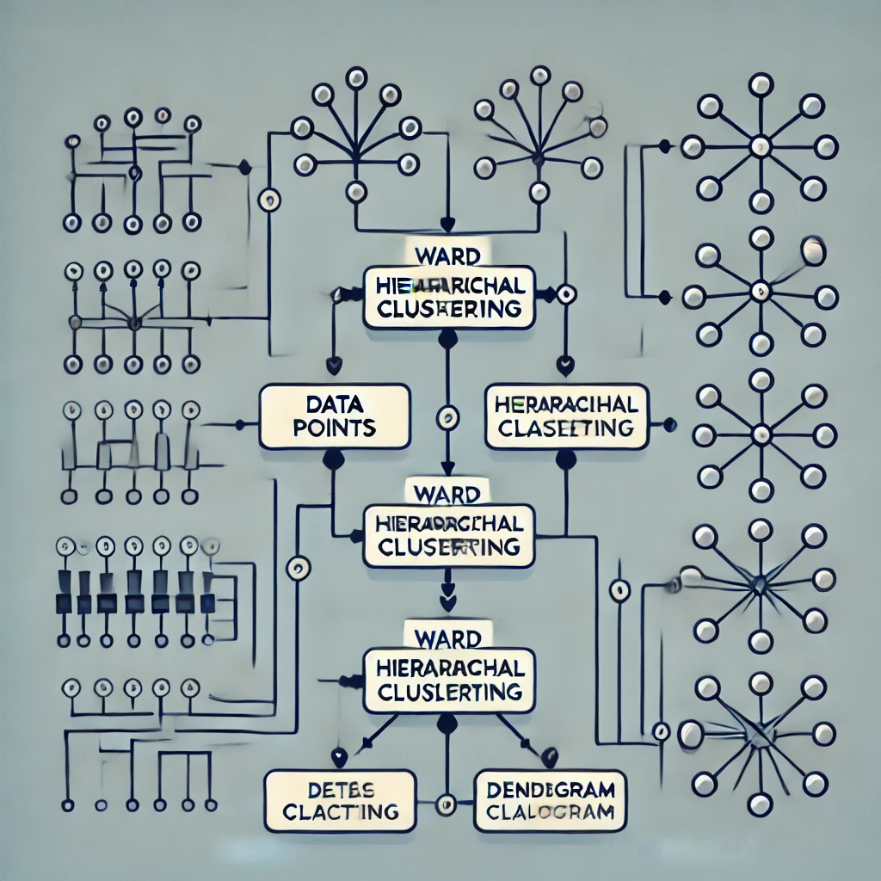
.
Hierarchical Clustering
A hierarchical clustering method that minimizes variance within clusters.
Merges clusters step-by-step to form a dendrogram.
Often used in data segmentation and image processing.

Slide 16
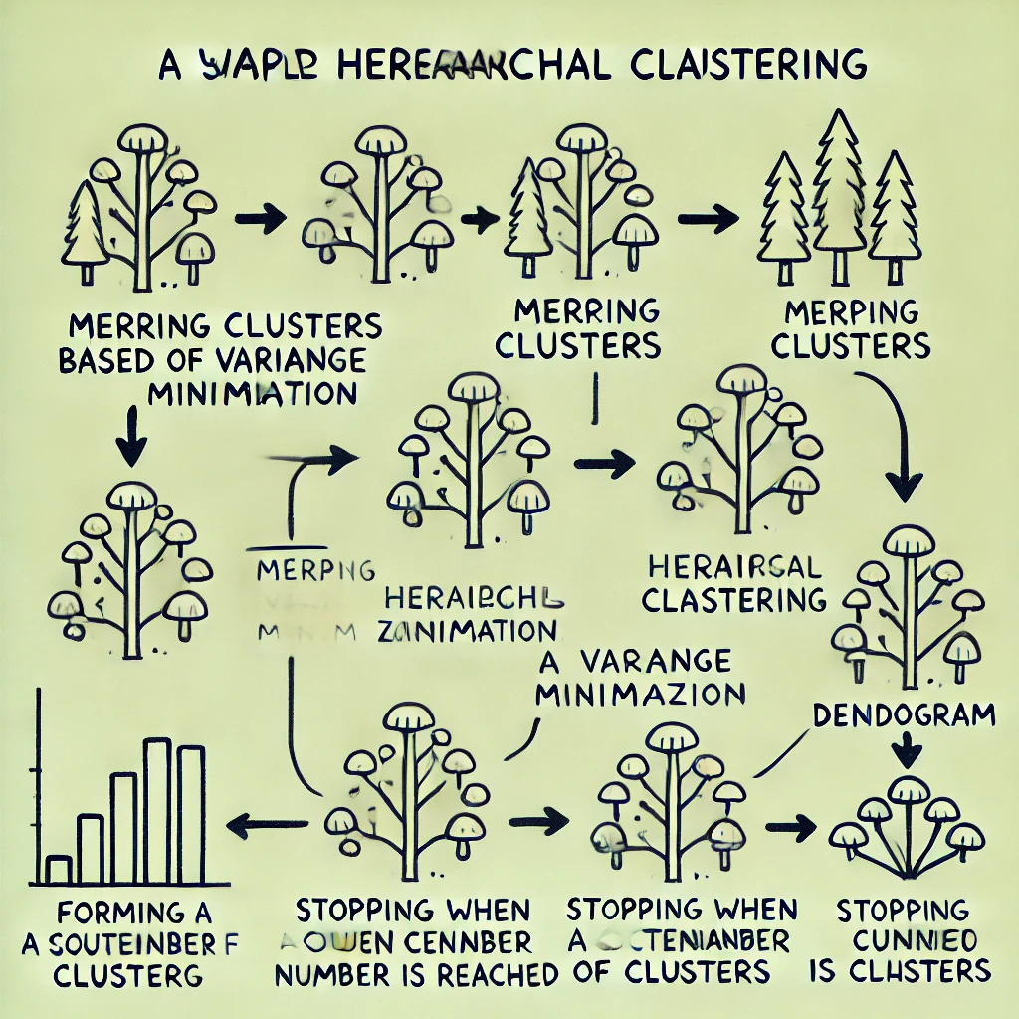
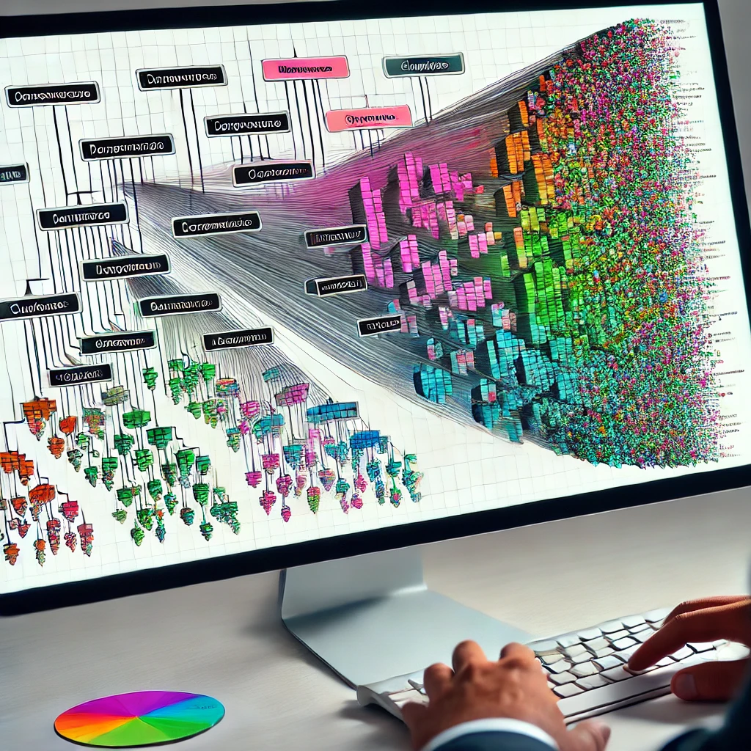
Minimizes Variance – It merges clusters by minimizing the increase in variance, leading to more balanced and meaningful clusters.
Creates a Hierarchy – Generates a dendrogram that allows for analysis at multiple levels of granularity.
No Need to Predefine Clusters – Unlike K-Means, it does not require specifying the number of clusters in advance.
Handles Various Data Types – Can be used on numerical, categorical, or mixed data types.
Useful for Small to Medium Datasets – Works well with moderate-sized datasets where hierarchical relationships are important.

Slide 17
THANK YOU

